Slide 1

Revenue Data Analysis Project
This presentation explores a detailed analysis of revenue data, utilizing data cleaning, SQL integration, and Power BI visualization to reveal valuable insights and inform key decisions.
SP
By - Aayush Vishwakarma
Rishav Kumar
Sakshi Prajapati

Slide 2

Outline
Introduction to the Project
Our Analytical Approach
Tools and Technologies Used
Overview of Revenue Analysis
Revenue Deep Dive
Top Performance Metrics
Revenue by Geography
Recommendations
Conclusion

Slide 3
Introduction to the project
Welcome to our comprehensive Revenue Data Analysis Project, a strategic initiative designed to transform raw financial data into actionable business insights. Our project encompasses an in-depth analysis of revenue streams across multiple categories, products, and geographical locations.
To achieve this, we've implemented a robust methodology that integrates advanced data cleaning, SQL processing, and Power BI visualization techniques. The core objective of this initiative is to deliver actionable insights that will optimize revenue generation and inform strategic decision-making.
Through this analysis, we aim to uncover valuable patterns, identify growth opportunities, and provide data-driven recommendations for revenue optimization.
.

Slide 4

Our Analytical Approach
1
1. Data Understanding & Import
Comprehensive review and import of raw data sources to establish analysis foundation
2
2. Data Cleaning & Preparation
Handling missing values, removing outliers, and standardizing data formats for accurate analysis
3
3. Analysis & Visualization
Extracting key insights and creating compelling visual representations of findings
4
4. Presentation & Deployment
Building interactive Streamlit dashboard and deploying final solution to GitHub

Slide 5




Tools and Technologies Used
Python for Data Cleaning
SQL Integration for Data Management
Power BI for Visualization
Python was used to clean and preprocess raw data, ensuring data accuracy and consistency for subsequent analysis.
Power BI facilitated the creation of interactive dashboards and reports, showcasing key revenue trends and insights in a visually appealing and insightful manner.
SQL was implemented to structure and manage the cleaned data, enabling efficient querying and data retrieval for further analysis.

Slide 6






Overview of Revenue Analysis
Total Revenue
Revenue from Commodities
Revenue from Mineral Leases
$108.45 billion
$29.37 million
$5.75 billion
Revenue from Final Products
Time Frame
2003 – 2023
$30.33 million
This provides an overview of total revenue and revenue contributions across different categories, giving a snapshot of overall performance over the last two decades.

Slide 7



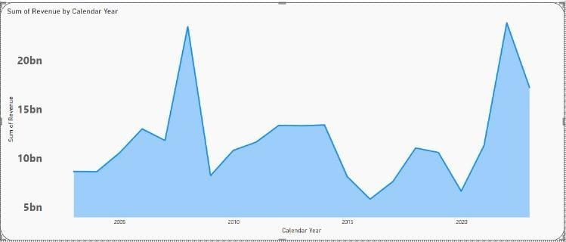
Yearly Revenue Trends
1
2
3
4
2003-2010
2011-2019
2020
2021-2023
Initial steady growth phase establishing baseline revenue patterns
Consistent upward trajectory with sustained growth in revenue generation
Peak revenue performance marking significant milestone
Continued strong performance maintaining elevated revenue levels
Steady Growth
Peak Performance
Sustained Success
Consistent upward trend over two decades
Notable revenue peak achieved in 2020
Maintained strong performance through 2023

Slide 8



Revenue Distribution by Land Category
Federal Land
Native American Land
Encompasses national parks, forests, and federal reserves generating substantial revenue through resource management and leasing activities
Sacred territories managed in partnership with tribal nations, contributing to economic development and resource utilization
Onshore Revenue
Offshore Revenue
Revenue from land-based operations including mineral extraction, leasing, and resource management activities across federal and tribal territories
Income generated from coastal and marine operations, including offshore drilling, marine resource management, and maritime leasing agreements

Slide 9
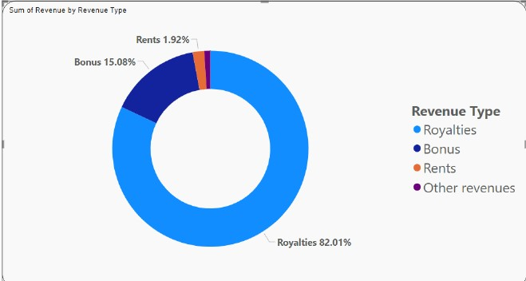
Revenue Type Breakdown
Our revenue structure shows a strategic balance between traditional royalties and diverse income sources, with other revenue types including rents and bonuses forming the backbone of our financial performance.
$37.5B
$208.5B
Royalties
Other Revenue
Direct revenue from resource extraction
Including rents, bonuses, and other income streams
Revenue Distribution
Royalties contribute 15% to the overall revenue stream
Dominant Income
Other revenue types constitute 82% of total income

Slide 10

Top Revenue-Generating Commodities
$9.2B
Oil & Gas Revenue
Primary revenue driver from energy sector
Additional Energy Sources
Mineral Resources
Valuable minerals including sodium deposits contribute to revenue diversity
Coal and renewable energy sources including wind and geothermal power
Growing Portfolio
Expanding mix of traditional and renewable energy sources driving sustainable growth

Slide 11

Top Revenue-Generating Products
Our revenue stream is dominated by key energy products, generating over $12B in annual revenue across processed and unprocessed categories.
$7.2B
Oil Products
Primary revenue driver through raw crude and refined products
$3.5B
Gas Plant Products
Major contributor from processing and distribution
$1.3B
Coal Resources
Significant revenue source from mining and processing operations
These top products form the backbone of our revenue structure, collectively representing over 80% of our total annual revenue across both processed and unprocessed categories.

Slide 12




Top Revenue-Generating Mineral Leases
Our mineral lease portfolio generates substantial revenue through diverse resource categories
Oil Leases
Natural Gas Leases
Other Mineral Leases
Primary revenue driver from crude oil extraction and production rights
Significant income from natural gas extraction and processing
Additional revenue from diverse mineral resources and extraction rights

Slide 13
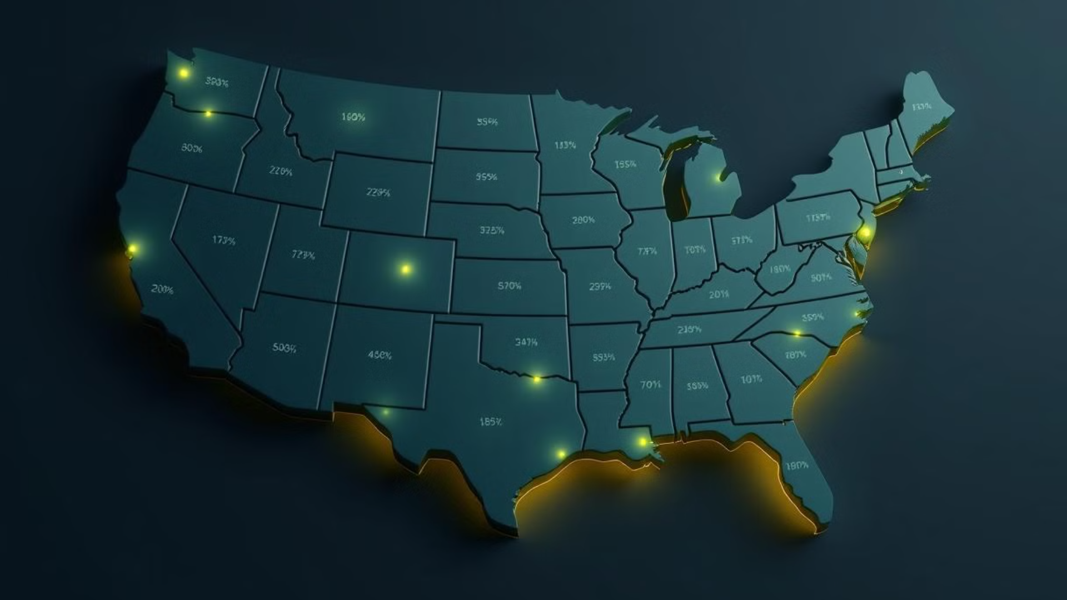
Revenue by Geography
Our revenue generation spans across diverse geographical regions, with significant concentrations in key areas across North America.
Top Revenue-Generating States
158B
35B
35B
Oklahoma
New Mexico
Wyoming
Highest revenue contribution
Strong energy sector
Key mineral resources
Leading Revenue Counties
Carbon
Campbell
₹158 billion in revenue
₹35 billion in revenue
Eddy County
Lea & Sublette
₹6 billion in revenue
₹5 billion each in revenue

Slide 14

Recommendations
1
Energy Portfolio Diversification
2
Geographic Revenue Optimization
3
Mineral Lease Management
Balance traditional oil & gas revenue with renewable energy investments, particularly in wind and geothermal power, to ensure sustainable long-term growth and market adaptability.
Expand operations in high-performing regions like Campbell, Eddy, and Lea counties while exploring new territories for mineral leases to maximize geographical revenue potential.
Strengthen focus on top-performing mineral leases across oil, natural gas, and diverse mineral resources, with particular emphasis on optimizing processing and distribution channels.

Slide 15

Conclusion
Our comprehensive revenue analysis reveals a robust and diverse portfolio, with strong performance across mineral leases, particularly in oil and natural gas sectors. The geographical concentration in key regions like Campbell, Eddy, and Lea counties provides a solid foundation for sustained growth. By leveraging our strengths in mineral lease management and implementing strategic recommendations for energy portfolio diversification, we are well-positioned to optimize revenue streams and capture new market opportunities.
Moving forward, our data-driven approach will continue to guide resource allocation, strengthen our market presence in high-performing regions, and drive sustainable growth across our diversified energy portfolio. This analysis provides a clear roadmap for maximizing returns while adapting to evolving market dynamics.

Slide 16
Thank You!

